Slide 1
P-1605 Process & Mechanical Condition Variables
Pascagoula
June. 2020
Ernesto Primera
Sr. Machinery Engineer

Slide 2
Process & Mechanical Condition Variables
Identify analysis variable (Vibration from AMS Machinery Manager).
Identify correlate or predictor variables (Process variable from IndX).
Criteria for data extraction and data cleaning.

Slide 3
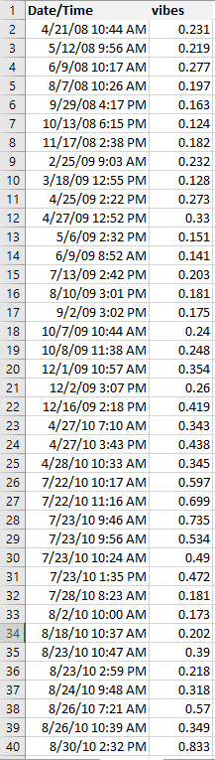
Process & Mechanical Condition Variables
Variable sent by Tony.
216 Vibration data points.
Time frame 2008 – 2020.

Slide 4
Process & Mechanical Condition Variables
Variable filtered sent by Tony.
Worst Case and Best Case.

Slide 5
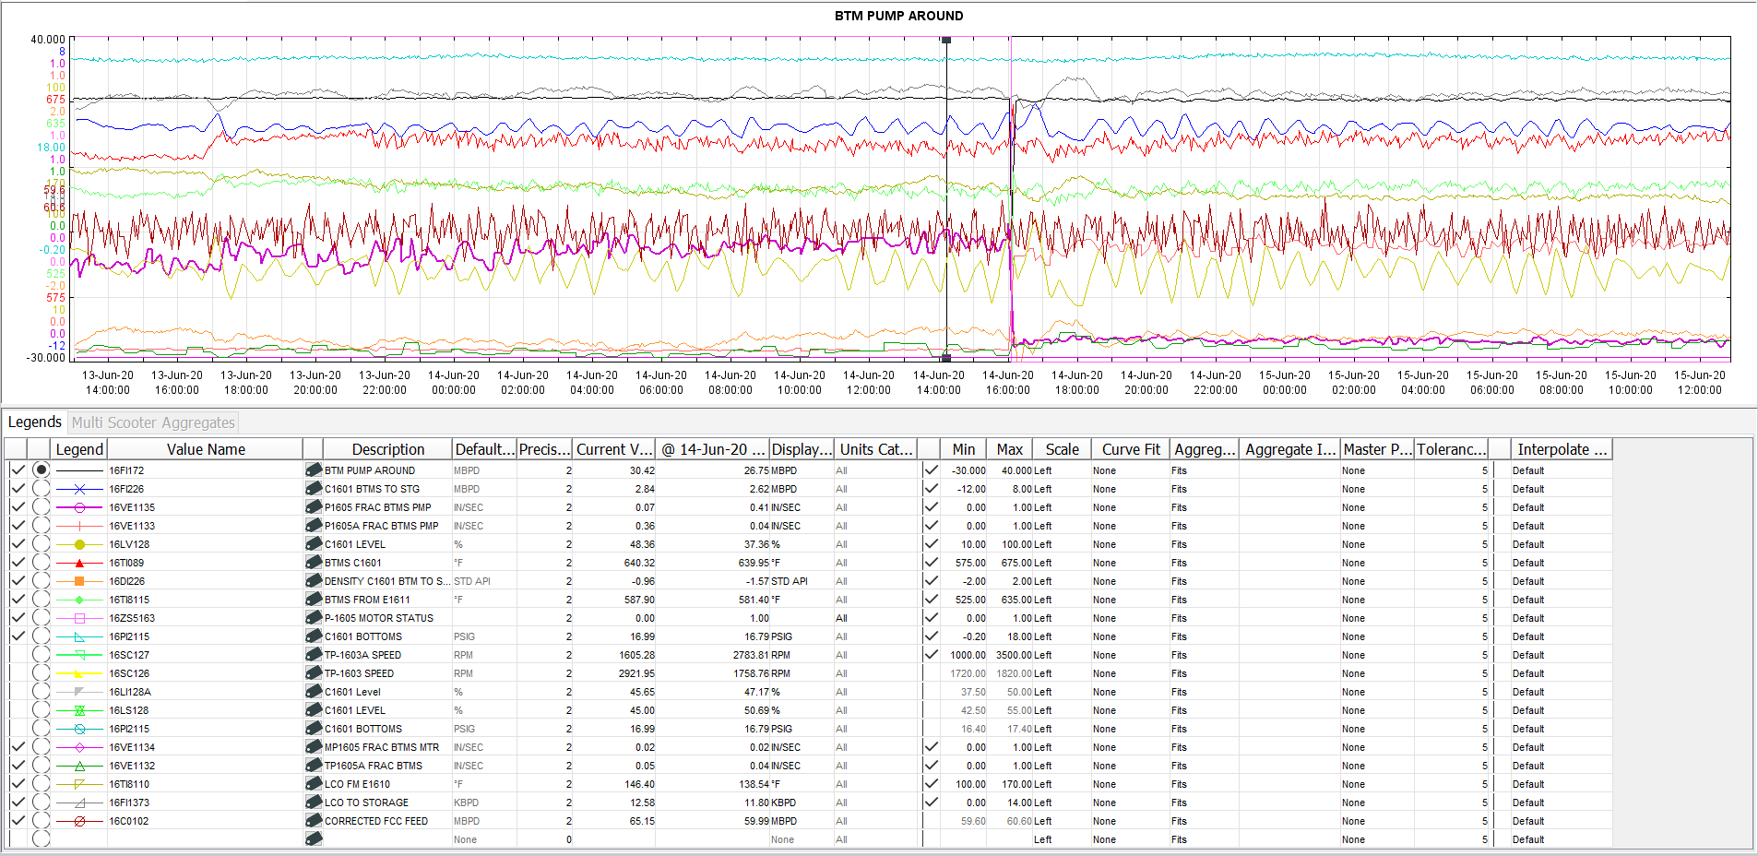
Process & Mechanical Condition Variables
Variable sent by Reggie.
There were 20 variables, but I removed the variable "Motor Status" as it is a categorical variable.

Slide 6
Process & Mechanical Condition Variables
Based on the Worst case and Best Case, I selected my starting point to extract the IndX data, with the criteria of three days of data that will include the day of high or low vibration, with the day before and after.
Example: Event: 10/6/2020 Data: 5th , 6th and 7th /10/2020.
As a lesson learned this generated a lot of data, the filter could have been only hours, but I had already downloaded the IndX data.
Of the 31 data available, I included only 20 with the lowest and highest values (Time Frame 2012 – 2020)

Slide 7
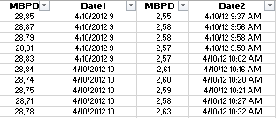
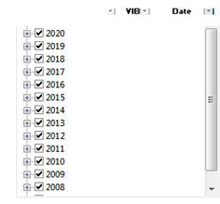

P-1605 How the dataset was created
I created a new excel sheet to be able ordered the variables in the same row by the same date and time, because the variables do not coincide in hour and minute (IndX data), however a range of 1 hour was used to select the variables.
Variables from IndX with their date and time:
Predictor variable VIB contains dates and time from 2008 to present
For the rest of the variables, there are events from the years 2012, 2019 and 2020 in the data.

Slide 8
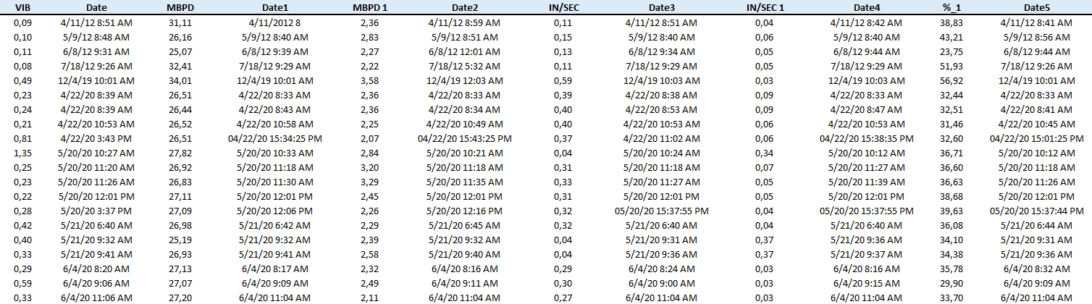
P-1605 How the dataset was created
The data and dates that coincide between the variable VIB and the rest of the variables were crossed, considering the events that occurred in the years 2012, 2019 and 2020 in the same range of hours. (It was done manually)

Slide 9
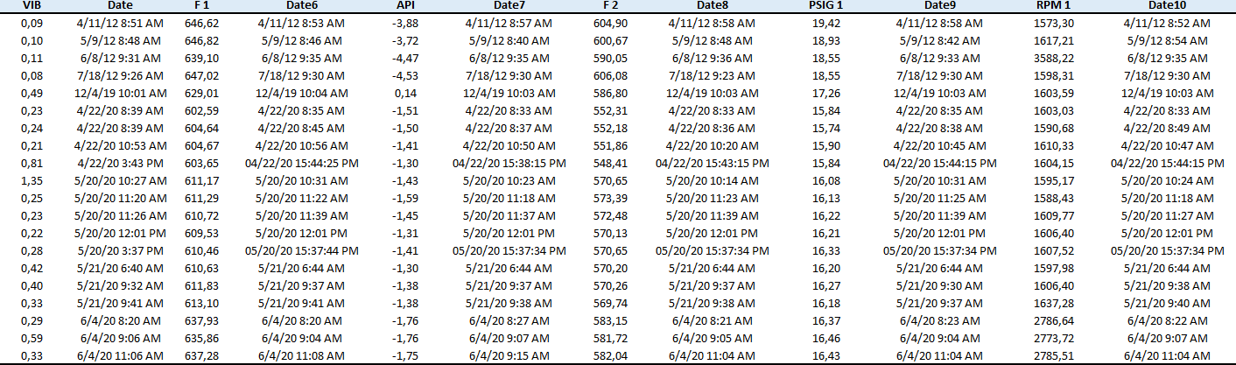
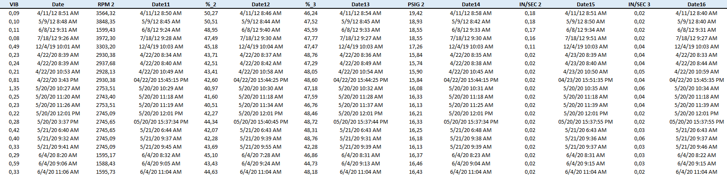
P-1605 How the dataset was created

Slide 10
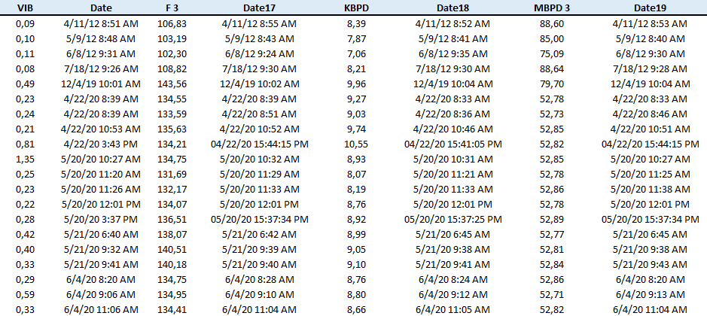
P-1605 How the dataset was created

Slide 11
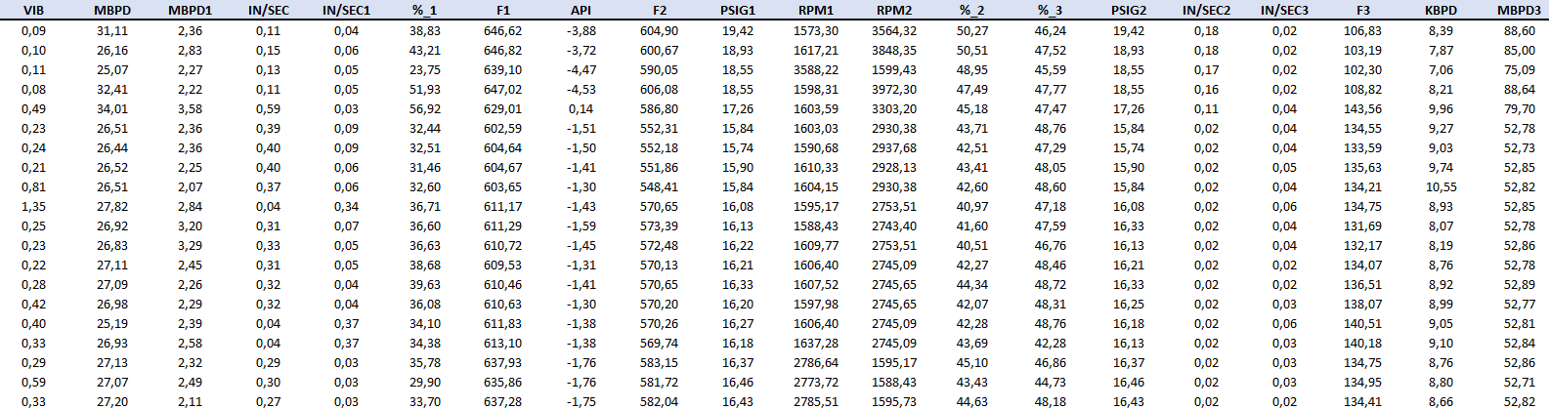
P-1605 How the dataset was created
Finally, the dataset is as follows:

